Slide 1
Team Lead 2's: How to Create a Simple 3D Game in Unity
Lucas, Luke, Jon, Paul, Victoria

Slide 2
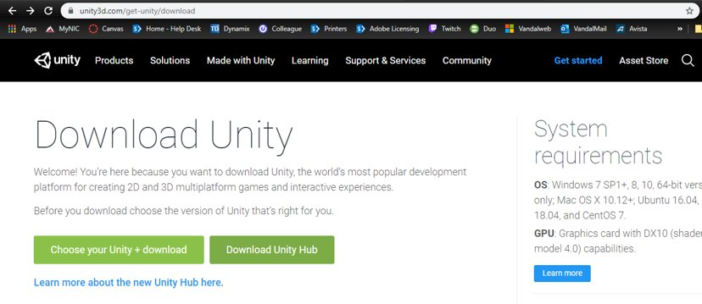
Installing Unity

Slide 3
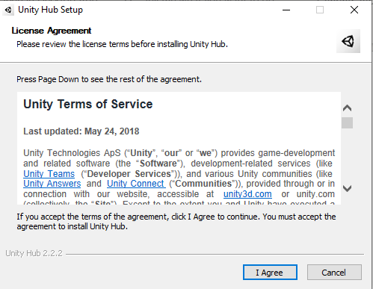
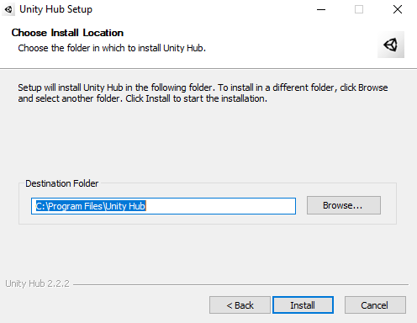

Slide 4
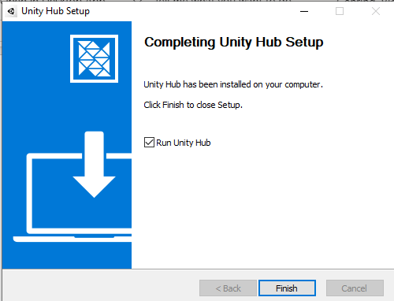
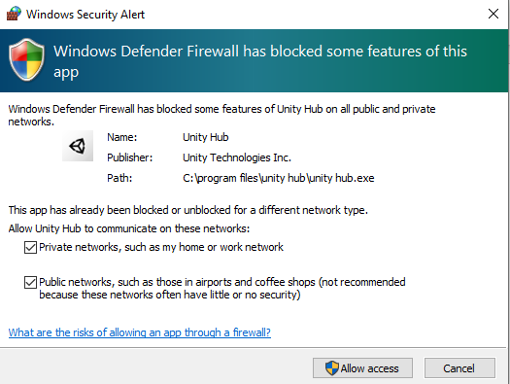

Slide 5
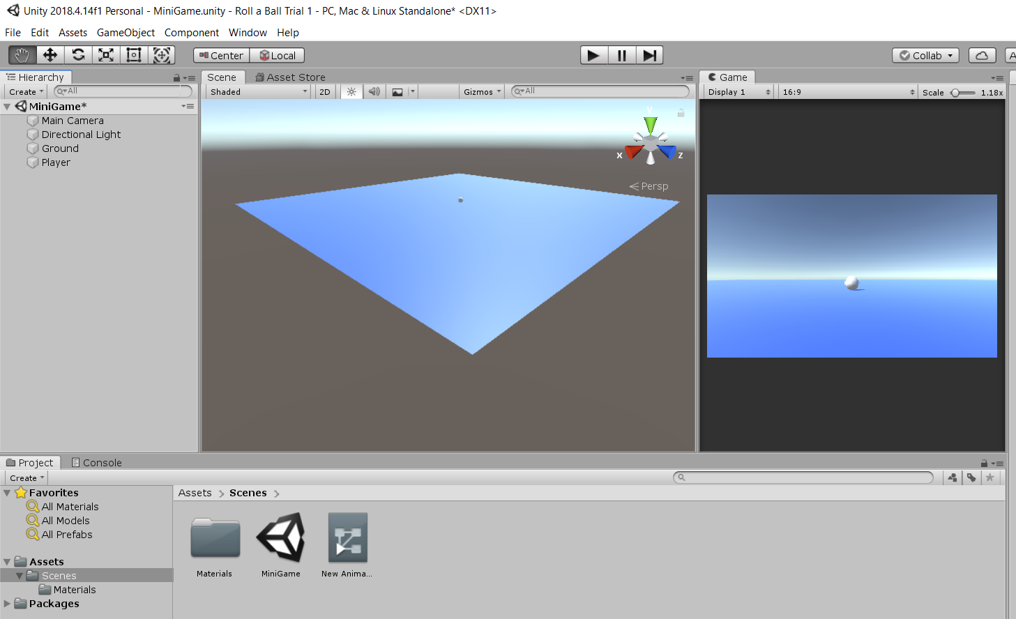
Setting up the Environment
Get to empty scene setup, save scene so we can build.

Slide 6
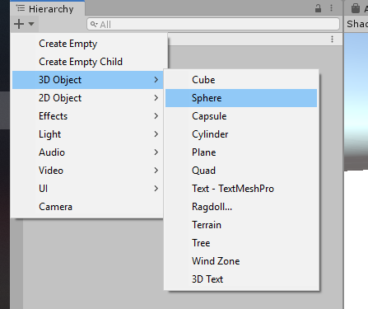
Creating the Player
For the purpose of our game, we will create a ball that can roll around.
We'll need a floor for our ball to roll around on, so we'll make them at the same time.
We'll name the sphere "Player".

Slide 7
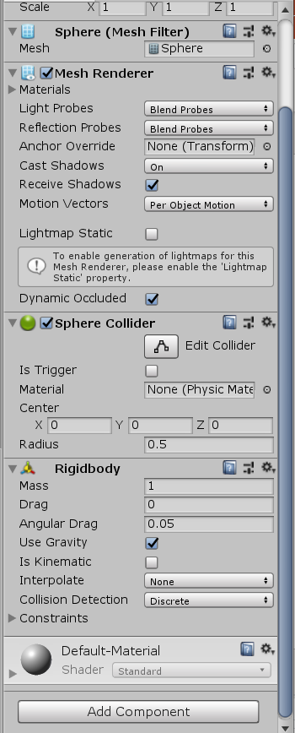

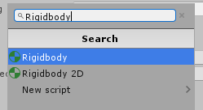
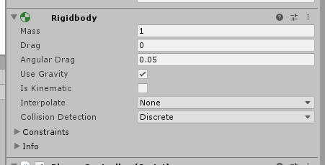
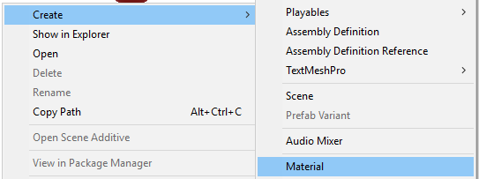
Creating the Player pt. 2
The "Player" (sphere) comes with a sphere collider, but you'll need to add a Rigidbody.
We'll also make a new material in order to change the player's color. Right-click in the Project view to do so.
Attach the material to the object when finished.

Slide 8
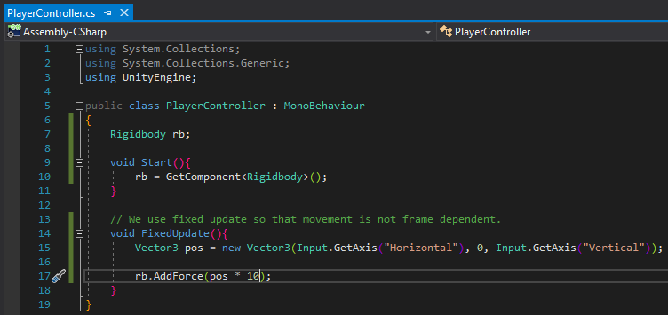
Moving the Player(Jon or someone else)
In order to move the player, we'll need to access the Rigidbody component on our "Player" object.
Once we access it, we can apply force based on the direction of the movement keys.
Note: movement should happen in FixedUpdate() instead of Update().

Slide 9
High Speed Rolling

Slide 10
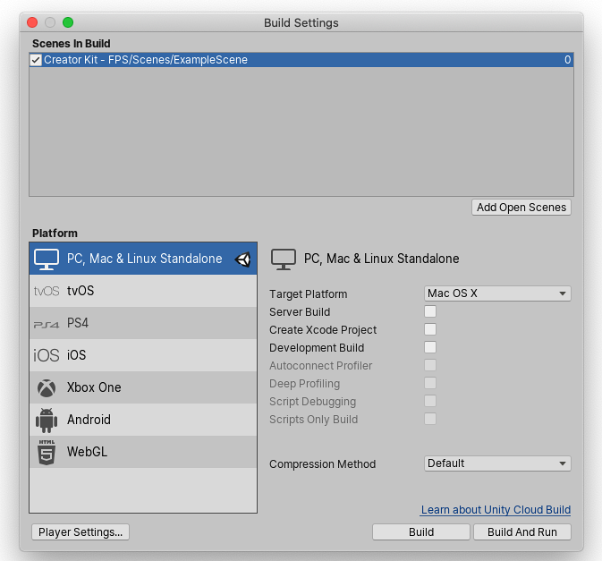
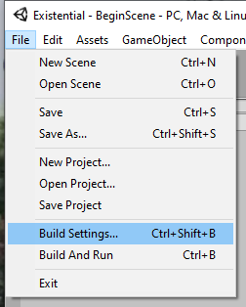
How to Export a complete game
Decide on a platform
Add open scenes
Pick a Destination Folder
Watch out for line ending conflicts etc.

Slide 11
More Mechanics(Jon if not moving the player)
Team leads could add stuff to the game if the presentation is too short, ex. We could add coin pickups, navmesh enemies, bouncy stuff, etc

Slide 12
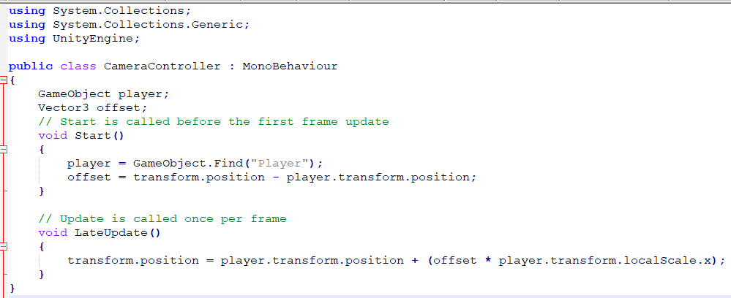
Example Camera Controller

Slide 13
From team leads doc...
2. Software Architect A software architect is an expert at software development who makes high-level design choices. For this class the software architect is responsible for creating a minimum viable product for your game. This is a first release that – although it is not sophisticated – is still a playable game.
Team member deliverables:
In the src/name directory put your basic C files with stubs for most functions. (Note: In this directory EVERYTHING goes into your subfolder. No one will look at this except you and the person your company hires 10 years from to take over your code. Target any documentation to help future developers. I.e. if you are using third party code, think about what happens if the company that made that code no longer exists.)
Give team lead 2 a list of your .cpp or .cs files and ensure you know how to add/delete to your variable.
• Work with your team lead to determine 1 or 2 functions from your section that are needed for your team leads minimum viable product. Complete those functions.
• Ensure you understand the process of updating, compiling and running your part of your team’s code. (You can NOT edit code owned by a team member. Only your own).
Software Development Specialists deliverables:
As an individual for your team:
• A minimum viable product: a program in Unity that is a playable game that integrates code from each member of your team.
o It should have a main character that is controllable by a user o It should have at least 2 NPCs (Non-player characters) that do something in response to the main character.
o Each person’s code must be called at least once in the demo ~ 13 ~
• Ensure that each team member can download the whole code and that it compiles on their system.
• Make a blank stress test level for team lead 3 to add to later.
• Going forward be prepared to handle issues with the main compile process.
Software Development Specialists Presentation:
• Following any of the many tutorials on-line create a simple 3D game in Unity from scratch.
Add to your Team Lead Presentation:
• Showing the running code is part of the presentation anyway, but make yours more focused. Point out when each person on the team’s code is run and what the impact is on the minimum viable product.

